Slide 1
Introduction to Neural Networks
Amal Joseph
Machine Learning Engineer @ Arcesium

Slide 2
Overview
Neurons from Brain
Artificial Neurons
Activation Functions
What’s happening inside a neuron?
How learning works in a neuron?
Forward Propagation
Backward Propagation
Cost Function
Gradient Descent
Deep Neural Network
Applications of Neural Networks
Hands-on

Slide 3
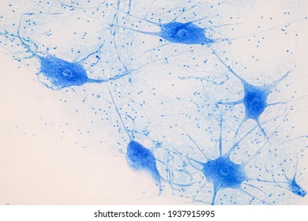
Neurons under a microscope

Slide 4
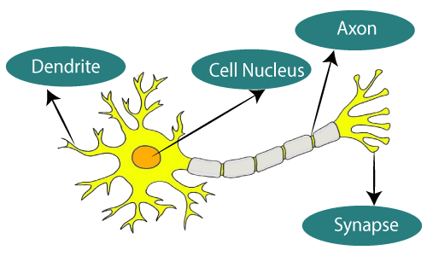
The Neuron

Slide 5
The Neuron
Dendrite
Receive and process signals from other neurons.

Slide 6
The Neuron
Dendrite
Receive and process signals from other neurons.
Axon
Transmits the signal to other neurons.

Slide 7
The Neuron
Dendrite
Receive and process signals from other neurons.
Axon
Transmits the signal to other neurons.
Synapse
How neurons are connected to each other.

Slide 8
Neurons by themselves are pretty much useless, but they could do incredible things when there are many neurons together.

Slide 9
Neurons by themselves are pretty much useless, but they could do incredible things when there are many neurons together.
But how can they work together?

Slide 10
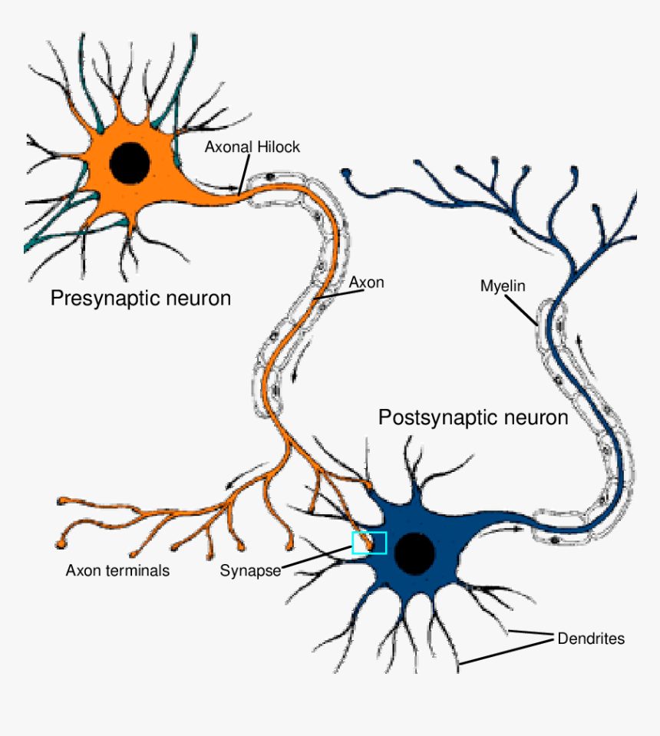
Through synapse, the axon of one neuron is connected to the dendrites of another neurons.
These neurons form a large, complex network to perform complex tasks

Slide 11
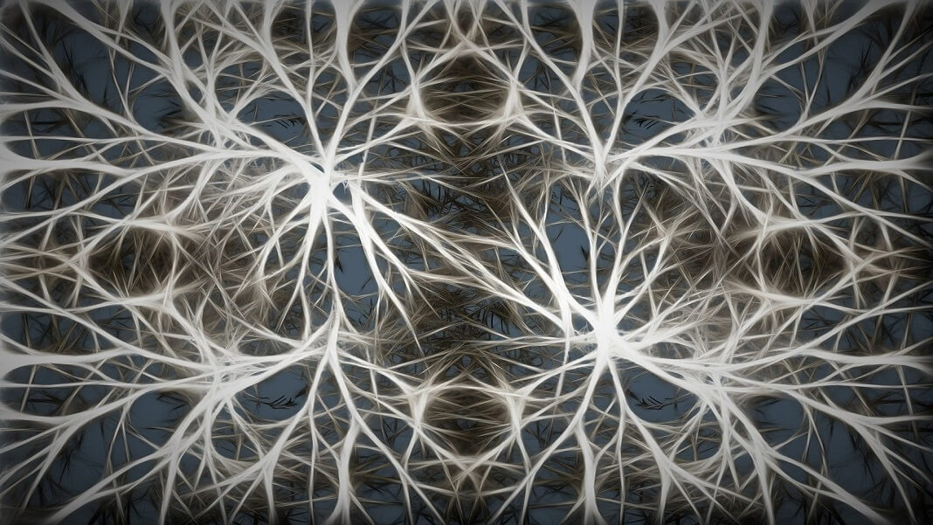

Slide 12
Artificial Neuron
Neuron

Slide 13
Artificial Neuron
Neuron
It’s also called as a node.

Slide 14
Artificial Neuron
Input Signal 1
Neuron
Input Signal 2
Input Signal 3

Slide 15
Artificial Neuron
Input Signal 1
Neuron
Input Signal 2
Output Signal
Input Signal 3

Slide 16
Artificial Neuron
Input Signal 1
Neuron
Input Signal 2
Output Signal
Input Signal 3
Let’s draw some parallels to the linear regression we studied earlier.!!

Slide 17
Artificial Neuron
Input Value 1
X₁
Neuron
X₂
y
Output Value
Input Value 2
.
.
.
X_{m}
Input Value m

Slide 18
Artificial Neuron
Input Value 1
X₁
Neuron
X₂
y
Output Value
Input Value 2
.
.
.
X_{m}
Input Value m

Slide 19
Artificial Neuron
Can be
Continuous (price)
Binary (yes/ no)
Categorical
Input Value 1
X₁
Neuron
X₂
y
Output Value
Input Value 2
.
.
.
X_{m}
Input Value m

Slide 20
Artificial Neuron
X₁
y₁
Output Value 1
Input Value 1
Neuron
X₂
y₂
Output Value 2
Input Value 2
.
.
.
X_{m}
y₃
Output Value 3
Input Value m

Slide 21
Artificial Neuron
Input Value 1
X₁
Neuron
X₂
y
Output Value
Input Value 2
.
.
.
X_{m}
Input Value m
Synapse

Slide 22
Artificial Neuron
Input Value 1
X₁
w₁
Neuron
X₂
w₂
y
Input Value 2
Output Value
.
.
.
w_{m}
X_{m}
weights
Input Value m
Weights decide which signals get passed along or to what extends does the signal gets passed along.

Slide 23
What’s happening inside the neuron?
Input Value 1
X₁
?
X₂
y
Output Value
Input Value 2
.
.
.
X_{m}
Input Value m

Slide 24
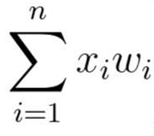
What’s happening inside the neuron?
Input Value 1
X₁
X₂
y
Output Value
Input Value 2
.
.
.
Step 1:
The input values are multiplied by their weights and summed up.
X_{m}
Input Value m

Slide 25
What’s happening inside the neuron?
Input Value 1
X₁
X₂
f
y
Input Value 2
Output Value
.
.
.
Step 2:
Apply an activation function to the sum.
X_{m}
Input Value m

Slide 26
What’s happening inside the neuron?
Input Value 1
X₁
X₂
f
y
Input Value 2
Output Value
.
.
.
The Activation Function decides what value is passed on as the output.
X_{m}
Input Value m

Slide 27
What’s happening inside the neuron?
Input Value 1
X₁
Step 3:
Neuron passes on the signal
X₂
f
y
Input Value 2
Output Value
.
.
.
X_{m}
Input Value m

Slide 28
Activation Functions
An Activation Function decides whether a neuron should be activated or not.
They introduce non-linearities in neural networks and enable the neural networks can learn powerful operations.

Slide 29
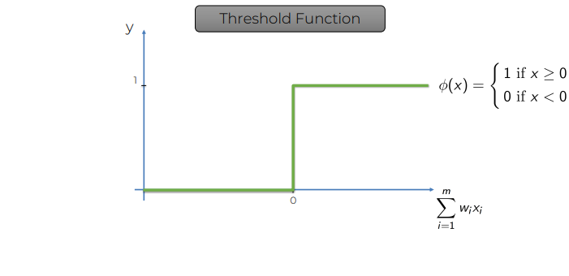
Activation Functions
Step Function

Slide 30
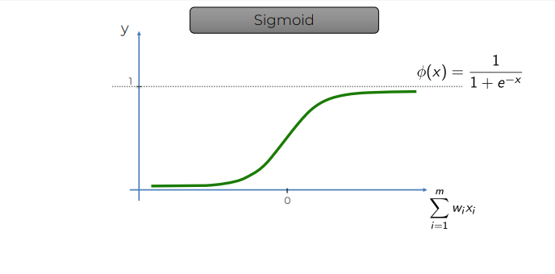
Activation Functions

Slide 31
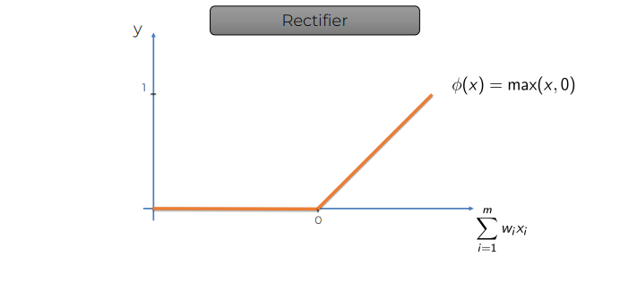
Activation Functions
Rectified Linear Unit (ReLU)

Slide 32
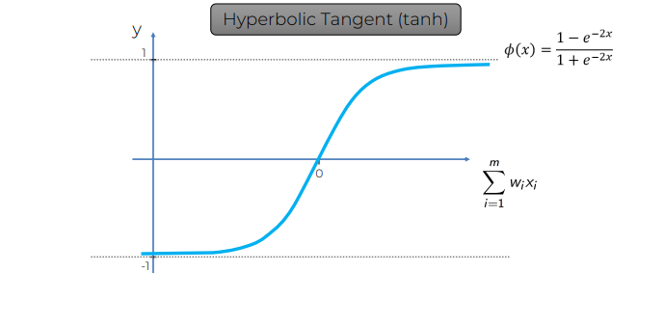
Activation Functions

Slide 33
Single Layer Feed Forward Neural Network
Perceptron
Input Value 1
X₁
X₂
f
y
Input Value 2
Output Value
.
.
.
X_{m}
Input Value m

Slide 34
How do Neural Networks Learn?
Input Value 1
X₁
X₂
f
ŷ
Input Value 2
Output Value
.
.
.
X_{m}
y
Input Value m
Actual Value

Slide 35
How do Neural Networks Learn?
1
Forward Propagation
Input Value 1
X₁
X₂
f
ŷ
Input Value 2
Output Value
.
.
.
X_{m}
y
Input Value m
Actual Value

Slide 36
How do Neural Networks Learn?
1
Forward Propagation
Input Value 1
X₁
X₂
f
ŷ
Input Value 2
Output Value
.
.
.
X_{m}
y
Input Value m
Actual Value

Slide 37
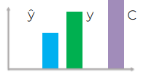
How do Neural Networks Learn?
1
Input Value 1
X₁
X₂
f
ŷ
Input Value 2
Output Value
.
.
.
X_{m}
y
Input Value m
Actual Value

Slide 38

How do Neural Networks Learn?
1
Input Value 1
X₁
X₂
f
ŷ
Input Value 2
Output Value
.
.
.
cost function
X_{m}
y
Input Value m
Actual Value

Slide 39
How do Neural Networks Learn?
1
Input Value 1
X₁
X₂
f
ŷ
Input Value 2
Output Value
.
.
.
cost function
X_{m}
y
Input Value m
Actual Value

Slide 40
How do Neural Networks Learn?
1
Let’s feed this information back to the neural network.
Input Value 1
X₁
X₂
f
ŷ
Input Value 2
Output Value
.
.
.
cost function
X_{m}
y
Input Value m
Actual Value

Slide 41
How do Neural Networks Learn?
1
Back Propagation
Input Value 1
X₁
X₂
f
ŷ
Input Value 2
Output Value
.
.
.
cost function
X_{m}
y
Input Value m
Actual Value

Slide 42
How do Neural Networks Learn?
1
Back Propagation
Input Value 1
X₁
w₁
X₂
w₂
f
ŷ
Input Value 2
Output Value
.
.
.
w_{m}
cost function
X_{m}
y
Input Value m
update the weights
Actual Value

Slide 43
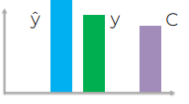
How do Neural Networks Learn?
2
Forward Propagation
Input Value 1
X₁
X₂
f
ŷ
Input Value 2
Output Value
.
.
.
cost function
X_{m}
y
Input Value m
Actual Value

Slide 44
How do Neural Networks Learn?
2
Back Propagation
Input Value 1
X₁
w₁
X₂
w₂
f
ŷ
Input Value 2
Output Value
.
.
.
w_{m}
cost function
X_{m}
y
Input Value m
update the weights
Actual Value

Slide 45
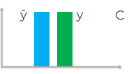
How do Neural Networks Learn?
3
Forward Propagation
Input Value 1
X₁
X₂
f
ŷ
Input Value 2
Output Value
.
.
.
cost function
X_{m}
y
Input Value m
Actual Value

Slide 46
How do Neural Networks Learn?
3
Back Propagation
Input Value 1
X₁
w₁
X₂
w₂
f
ŷ
Input Value 2
Output Value
.
.
.
w_{m}
cost function
X_{m}
y
Input Value m
update the weights
Actual Value

Slide 47
How do Neural Networks Learn?
Input Value 1
X₁
w₁
X₂
w₂
f
ŷ
Input Value 2
Output Value
.
.
.
w_{m}
We finally end up having the optimal weights that would gives us the best predictions.
X_{m}
Input Value m

Slide 48
How do Neural Networks Learn?
Input Value 1
X₁
w₁
X₂
w₂
f
ŷ
Input Value 2
Output Value
.
.
.
w_{m}
The process of reducing the cost function/ optimizing the neural network weights is called GRADIENT DESCENT
X_{m}
Input Value m

Slide 49
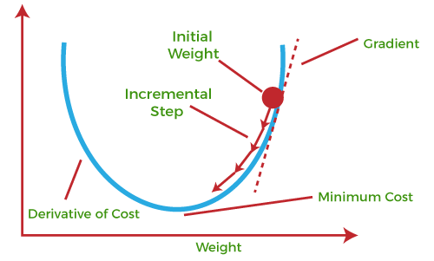
Gradient Descent
It helps in finding the local minimum of a function.

Slide 50
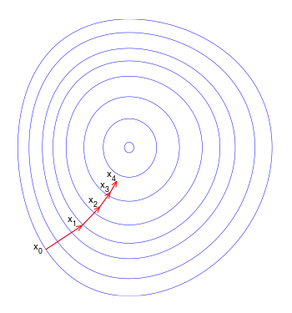
Gradient Descent
It helps in finding the local minimum of a function.

Slide 51
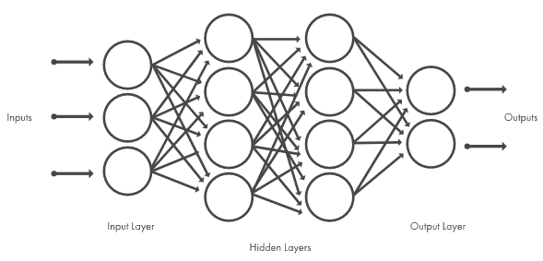
Deep Neural Networks
Deep neural networks, or deep learning networks, have several hidden layers with many artificial neurons linked together.

Slide 52
What are neural networks used for?
Medical diagnosis by medical image classification
Visual recognition in self-driving cars so they can recognize road signs and other road users
Facial recognition system
Virtual assistants like Amazon Alexa
Automated virtual agents and chatbots
Document summarization and article generation for a given topic
Recommendation Engines

Slide 53
Time for Hands On
Get Colab notebook from bit.ly/day10_notebook

